Slide 1
A Public Friendly Approach to Sharing Water Quality Data
Indiana Watershed Leadership Academy
May 20th, 2015

Slide 2
Overview
Water Monitoring Program
Problem
Project Description
“Demo”
Behind the Scenes
Suggestions?

Slide 3
SJRBC Water Monitoring Program
Began in 2014
Goal: Compiling water quality data on waterbodies within our watershed lacking data
3-year cycle
10-20 sites per year
Each site sampled monthly for 1 year
Sites revisited every 3 years

Slide 4
Parameters
pH
Temperature
D.O.
B.O.D.
Chlorides
Conductivity
Dissolved Solids
E. coli
Nitrates/Nitrites
Phosphorus
Turbidity
Suspended Solids
Flow

Slide 5
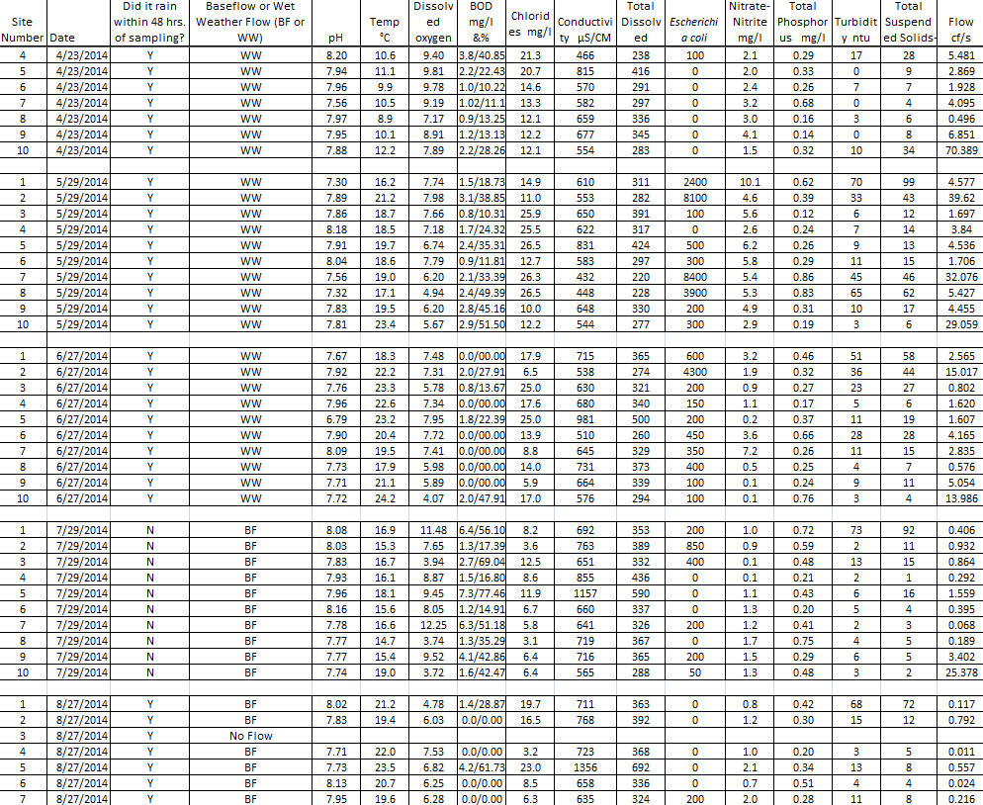
So…..now what?

Slide 6
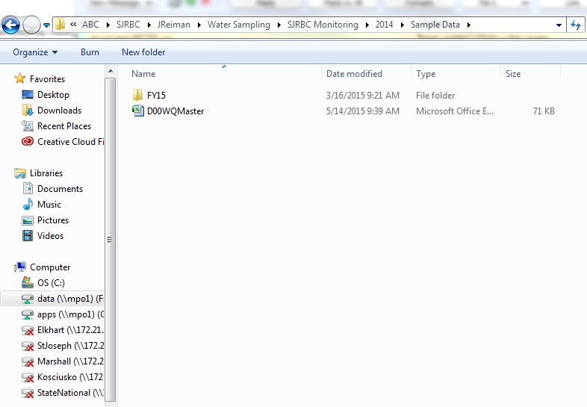
So…..now what?

Slide 7
So…..now what?
Public
Educators
Scientists
Engineers
Planners

Slide 8
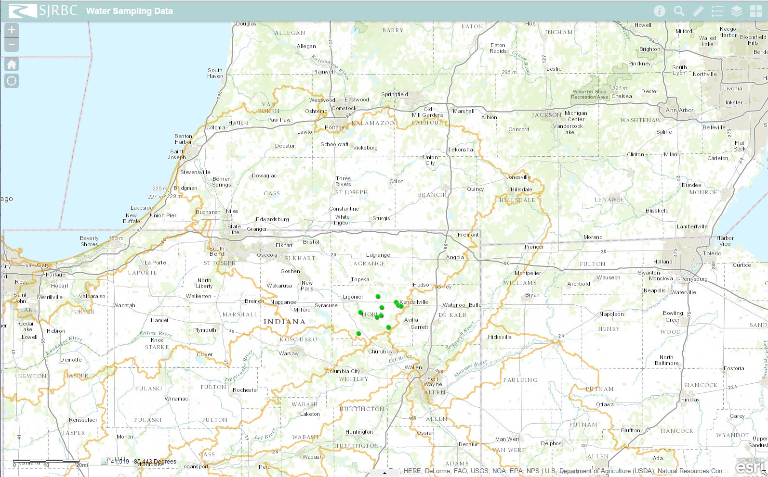

Slide 9
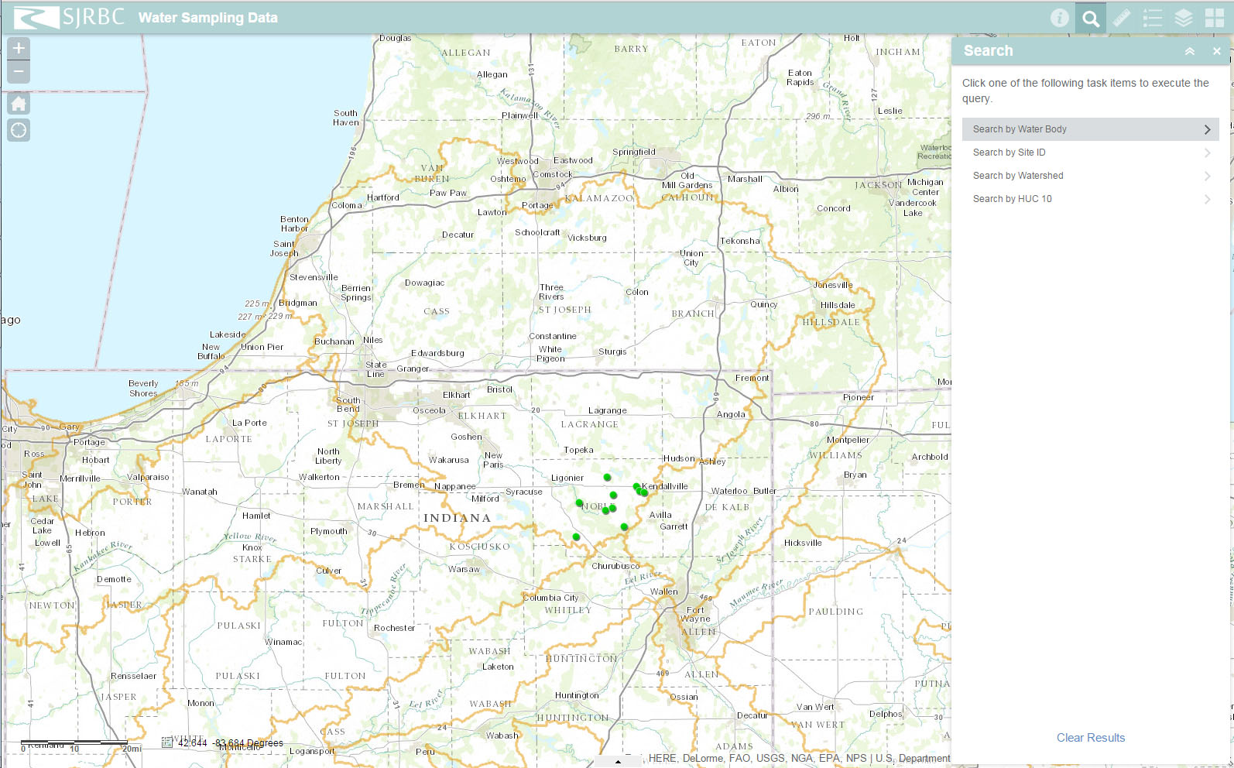

Slide 10
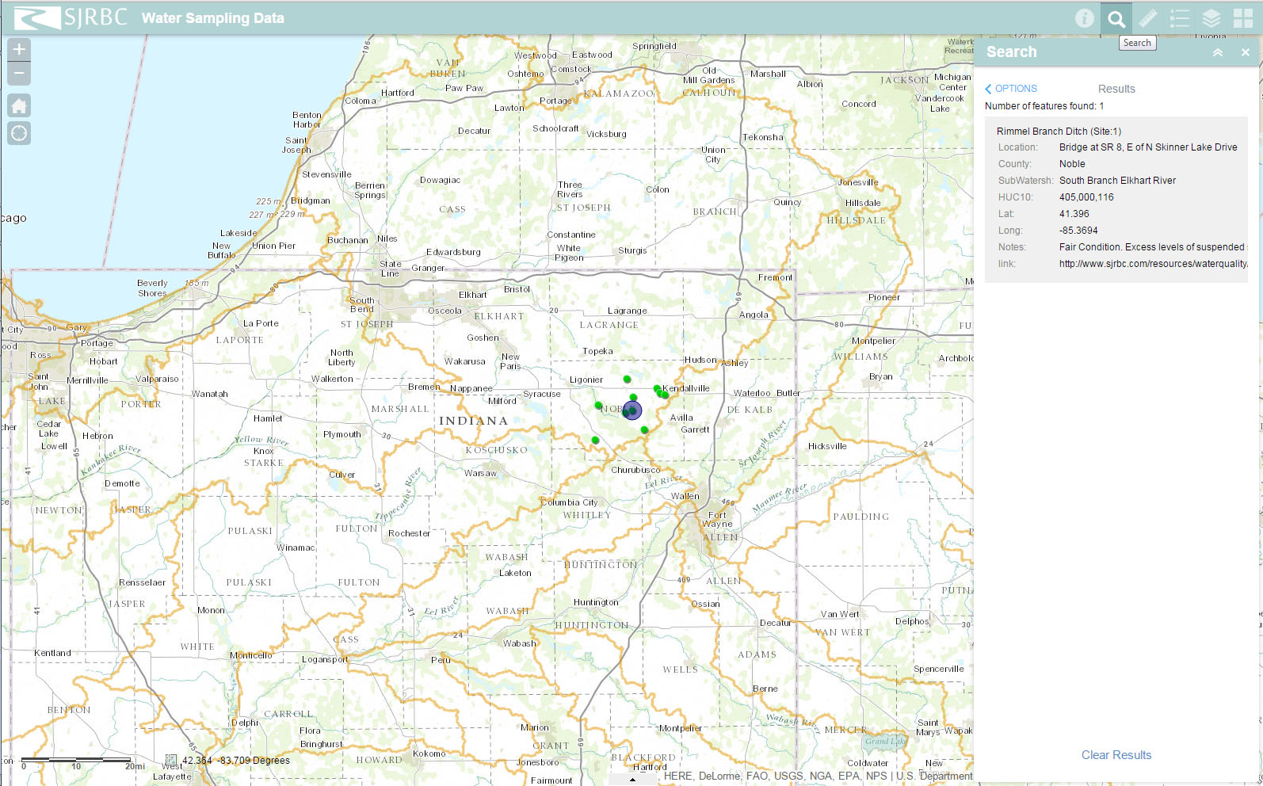

Slide 11
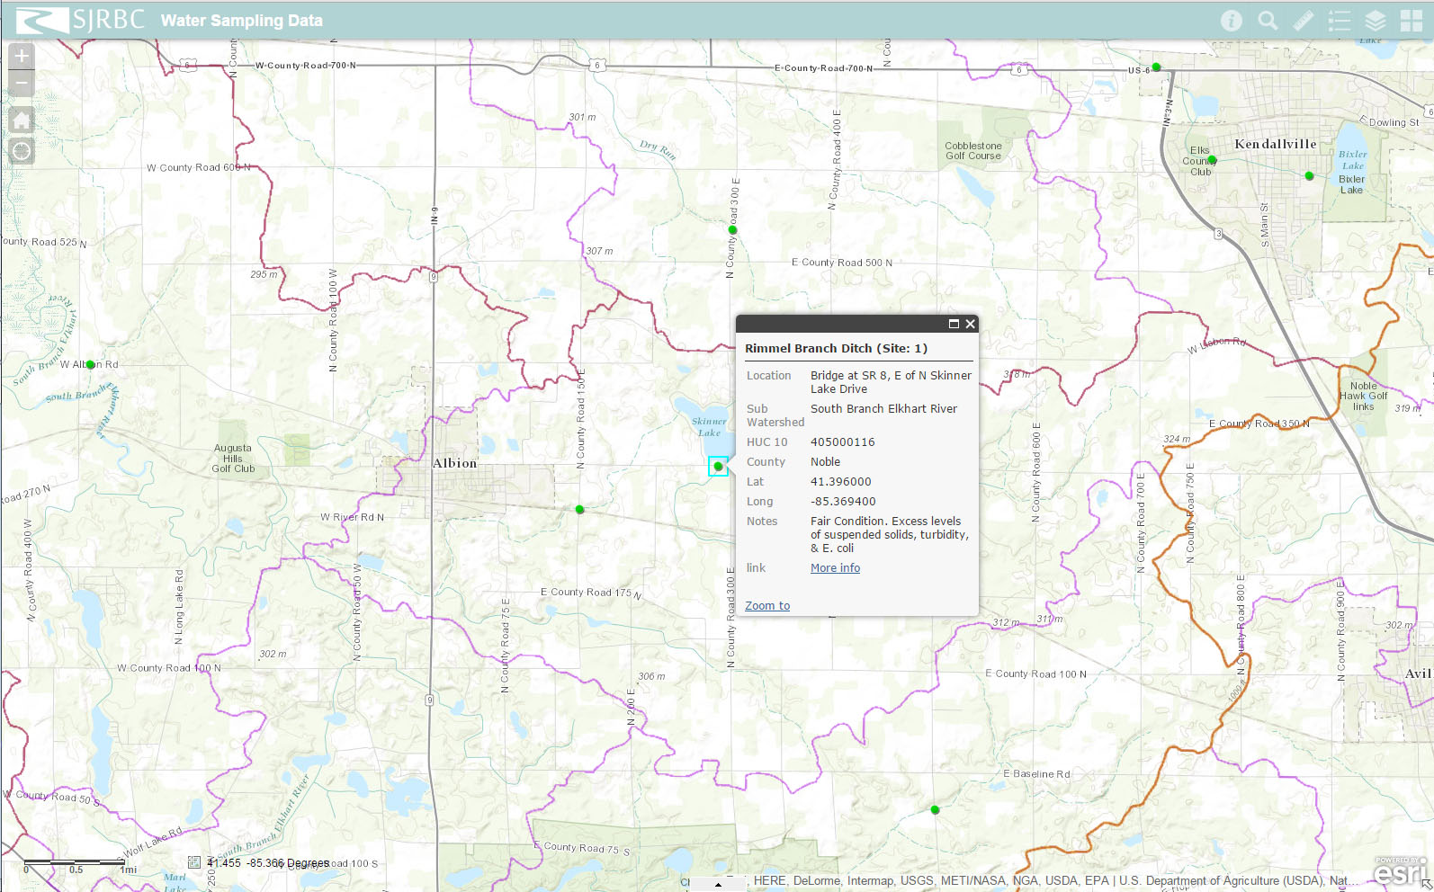

Slide 12
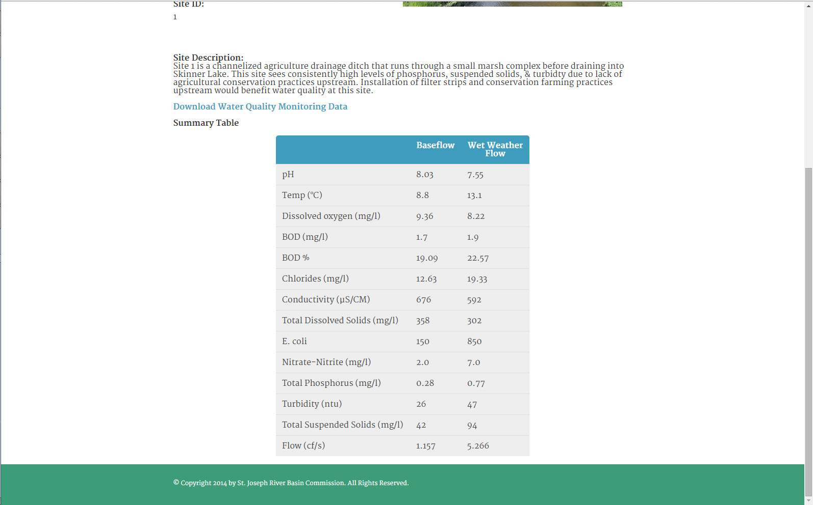

Slide 13
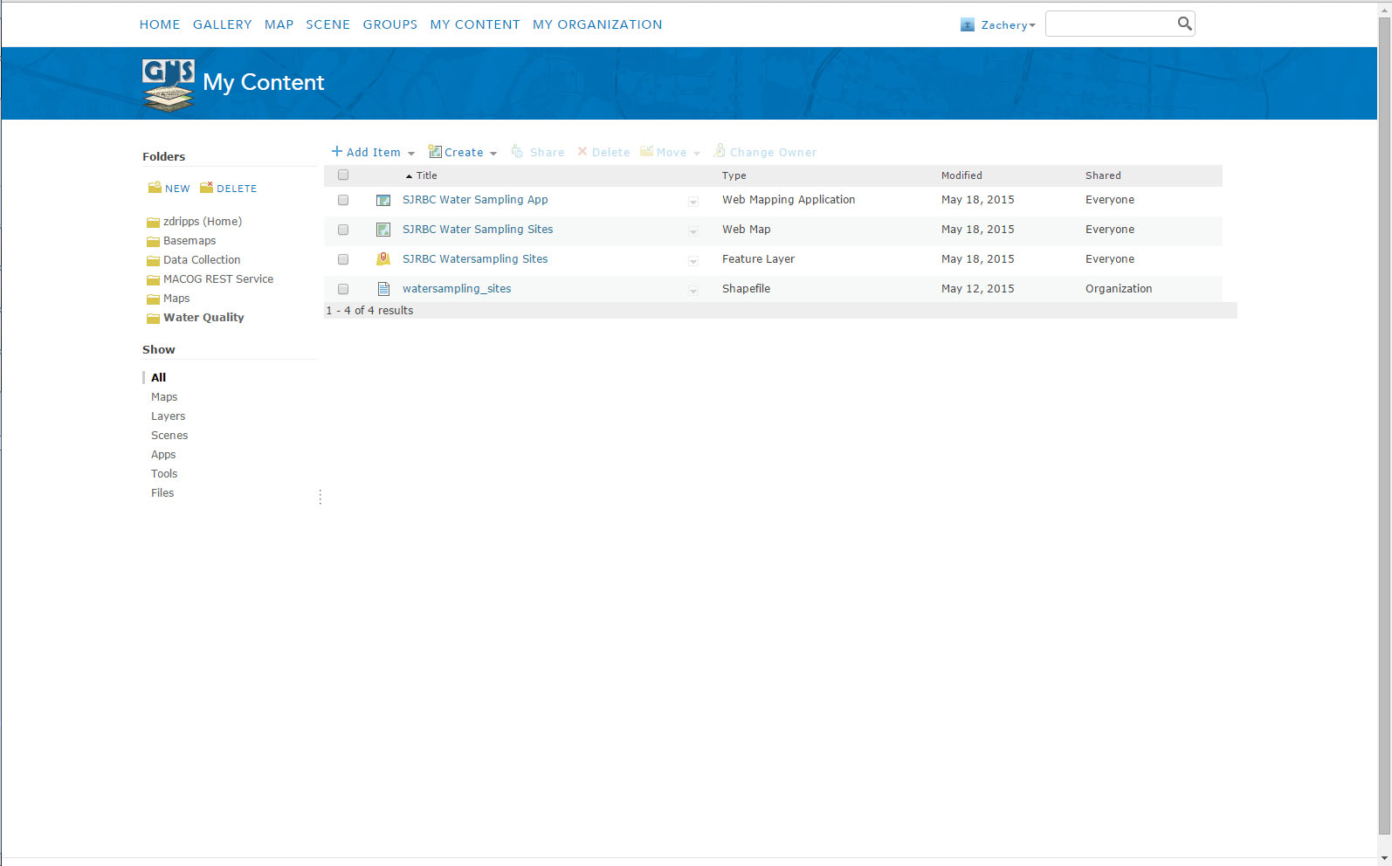

Slide 14
Suggestions?

